Slide 1
Autocad 101
Drawing Set-up & Introduction to CADD

Slide 2
Open AutoCAD Architecture.
2. Find the folder labeled AUTODESK.
4. Open AUTOCAD ARCHITECTURE 2016 – ENGLISH.
1
3
1. Open the start menu, choose ALL PROGRAMS
3. Open the folder labeled AUTOCAD ARCHITECTURE 2016 – ENGLISH.
2
4

Slide 3
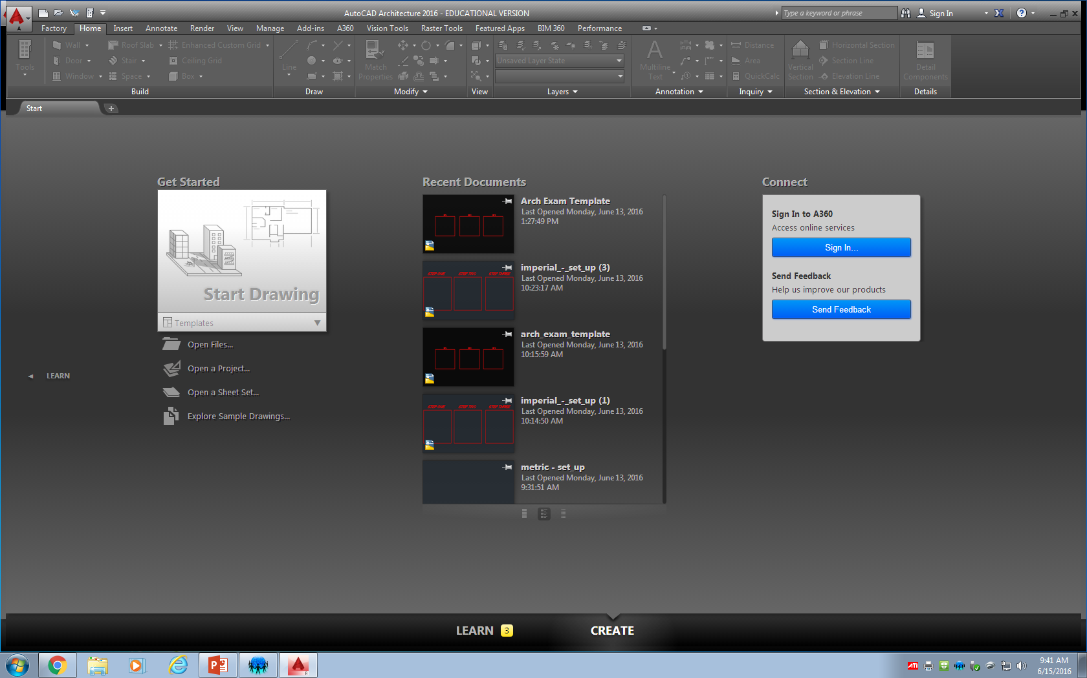
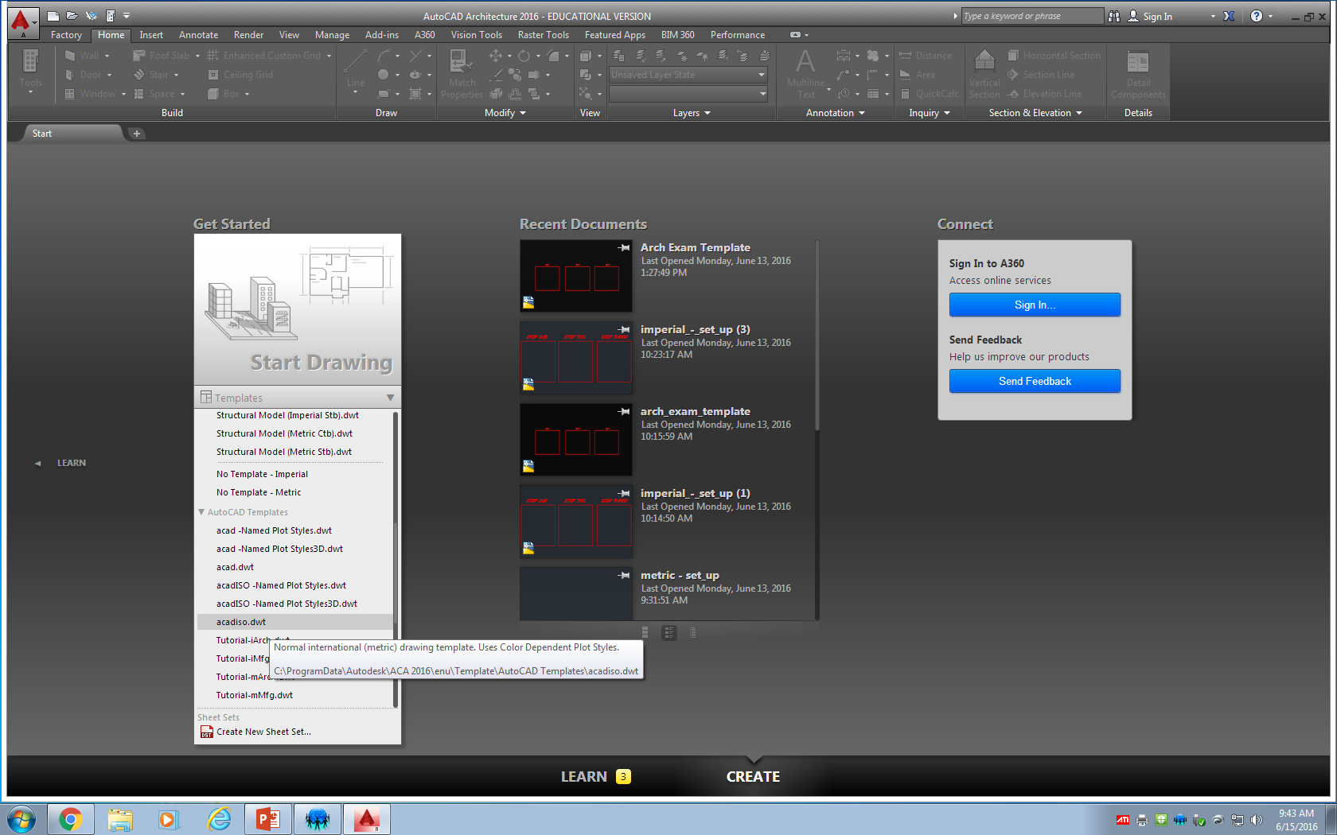
Set-up a metric drawing.
Be patient, it may take a moment to load.
Choose template.
Scroll down to find acadiso.dwt.
Select it.

Slide 4
AutoCAD TIP #1
To scroll in and out, use the ‘wheelie-ball’ on your mouse. Try that now.
To move around the screen, push down the ‘wheelie-ball’ and move your mouse around the screen.

Slide 5
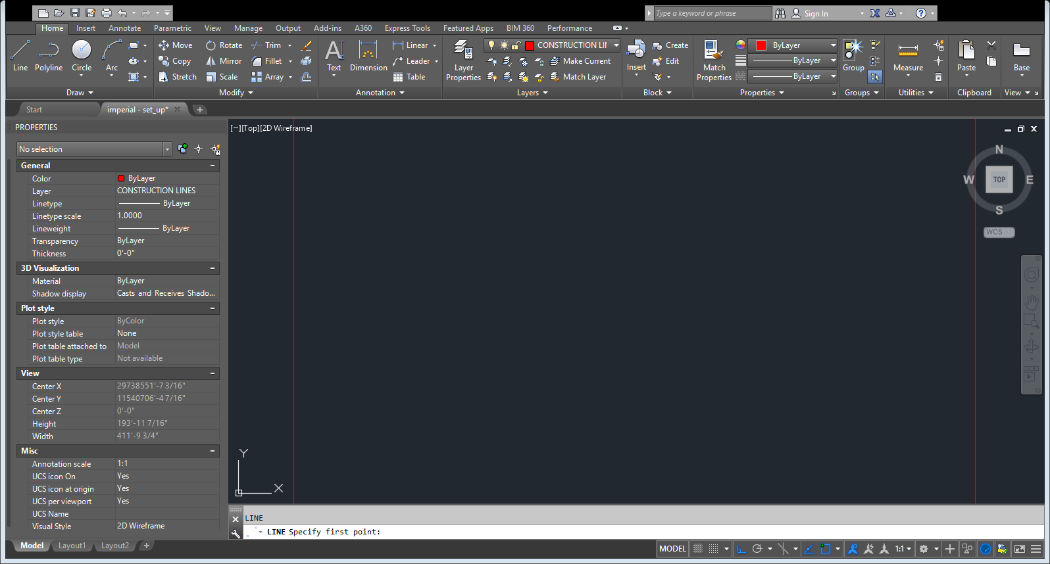
AutoCAD TIP #2
When you type a command, it will show up in the COMMAND BAR.
Watch the command bar for prompts or instructions throughout your drawing(s).

Slide 6
Set-up layers.
Type in LAYER → hit ENTER
Find the NEW LAYER button → click it.
Create the following layers. Be sure that you are using all capital letters.
Note: watch for changes in each column.

Slide 7
AutoCAD TIP #3
Tabs are found at the top of your screen.
Each tab categorizes various commands in organized groups.
Click on various tabs to explore AutoCAD.

Slide 8
Set-up text.
Click on the ANNOTATE tab.
Find the small arrow in the bottom right corner of the TEXT block → click it.
Choose STANDARD, in left box → then click NEW on the right side.
Create the following TEXT STYLES (all capitals):
TITLEBLOCK HT: 4.0mm
DIMENSION HT: 2.0mm
ISO30 HT: 2.0mm OBLIQUE ANGLE: 30.0
ISO330 HT: 2.0mm OBLIQUE ANGLE: 330.0
Click APPLY → click CANCEL.

Slide 9
Set-up dimension.
Click on the ANNOTATE tab.
Find the box in the DIMENSION block → click it to show a drop down menu.
Click MANAGE DIMENSION STYLE.
Choose ISO-25, in left box → then click NEW on the right side.
On the next slide, follow along and complete each of the windows. Be sure that you do not miss anything.

Slide 10
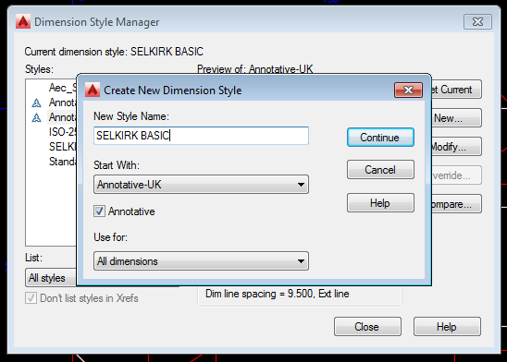
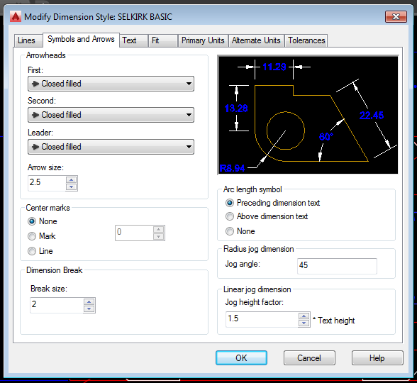
Dimension settings.
Note: Follow the next few slides. Check each window VERY carefully for any changes. Small discrepancies can make a huge difference in the appearance of your dimensions.
If you would like a PDF copy of the dimension set-up, it can be found on selkirkdrafting.weebly.com under Videos & Resources.
ISO-25
Name your new dimension style SELKIRK BASIC
Start with: ISO-25

Slide 11
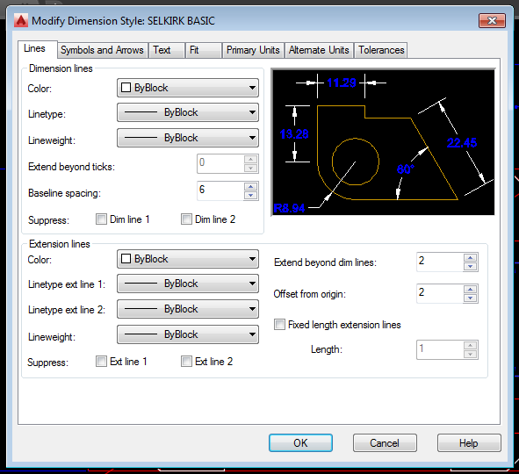
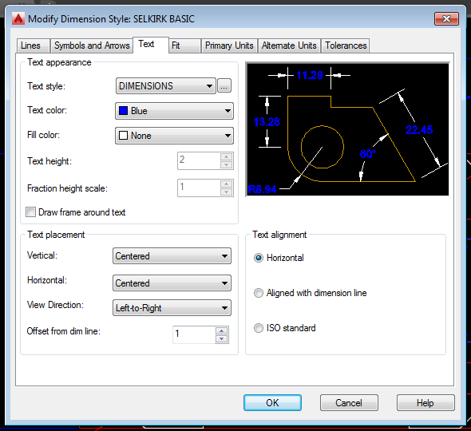

Slide 12
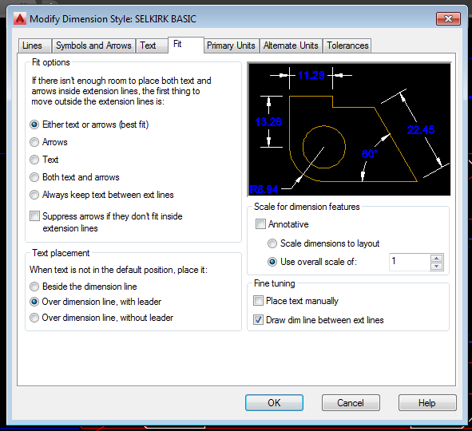
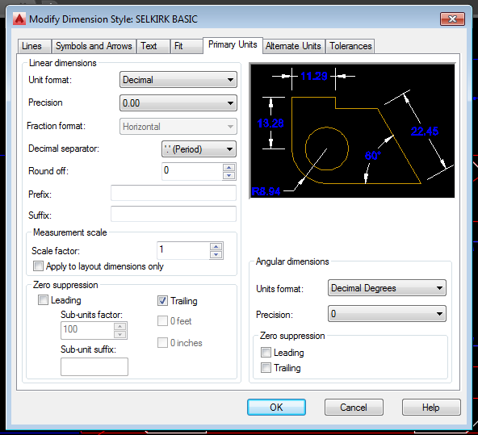

Slide 13
Be sure to save the drawing to your STUDENT NUMBER directory (on the server). DO NOT SAVE TO MY DOCUMENTS!
SAVE!

Slide 14
Common AutoCAD commands to know.
SHORTCUT COMMAND
L LINE
DT DYNAMIC TEXT
C CIRCLE
M MOVE
RO ROTATE
A ARC
CO COPY
O OFFSET
SHORTCUT COMMAND
E ERASE
EX EXTEND
F FILLET
H HATCH
MA MATCH PROPERTIES
PROP PROPERTIES MENU
F3 OBJECT SNAP ON/OFF
F8 ORTHOGRAPHIC ON/OFF

Slide 15
AutoCAD TIP #4
If you need to change any item (line, circle, dimension), you will find it in the PROPERTIES MENU.
If you do not see the properties menu – type, PROP (followed by ENTER) to make it appear.

Slide 16
If AutoCAD shuts down unexpectedly (crashes) and it asks you to save, DO NOT SAVE! You could lose your entire drawing.
SAVE OFTEN

Slide 17
How to submit an AutoCAD file.

Slide 18
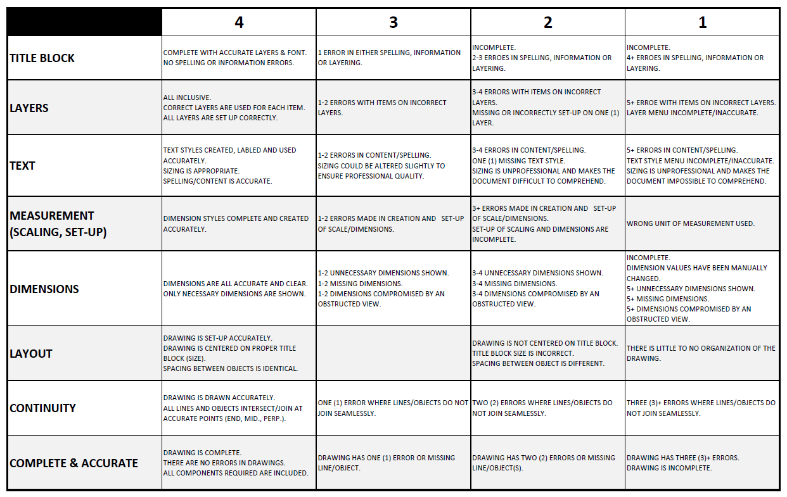
AutoCAD Rubric

